Slide 1

IoT – ESP8266
Beginning ESP8266 Workshop
Bruce Reagan
September 2, 2015

Slide 2
IoT - Beginning ESP8266 - Workshop
A two hour work shop to introduce attendees to the basics of the ESP8266 WiFi Microcontrollers and the NodeMCU firmware.
After completing this work shop attendees will have experience with and will be able to configure the ESP8266 on a bread board for prototyping circuits and programs.
Attendees will become familiar with IDEs and procedures to “Flash” new firmware to the controller.
Upon completion, attendees will have a working prototype of an ESP controlled active ‘night light’.
Attendees will also receive an introduction/demonstration of ESPs communicating over the inter/intranet via TCP and MQTT protocols.

Slide 3
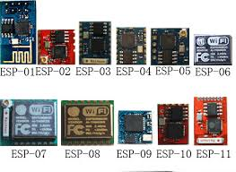
ESP8266 Version Overview

Slide 4
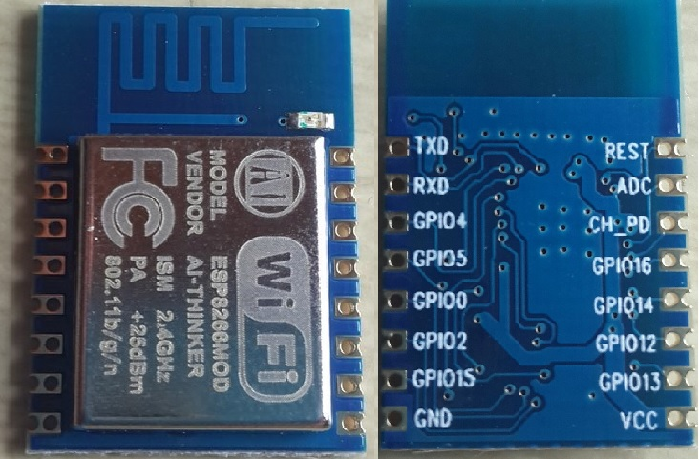
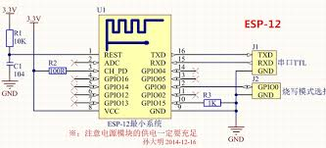
ESP8266-12

Slide 5
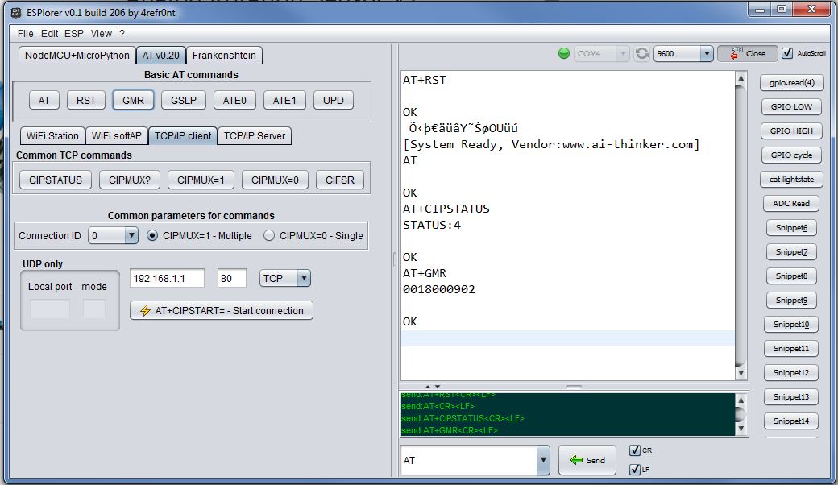
IDEs
ESPlorer
Original ai-thinker firmware

Slide 6
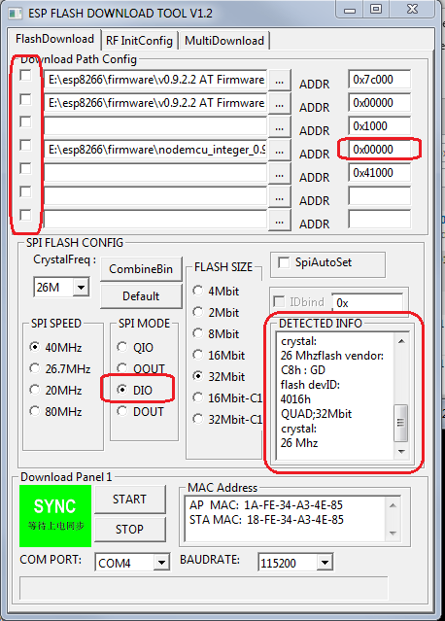
Flash Download Tool v1.2
Don’t forget to format!

Slide 7
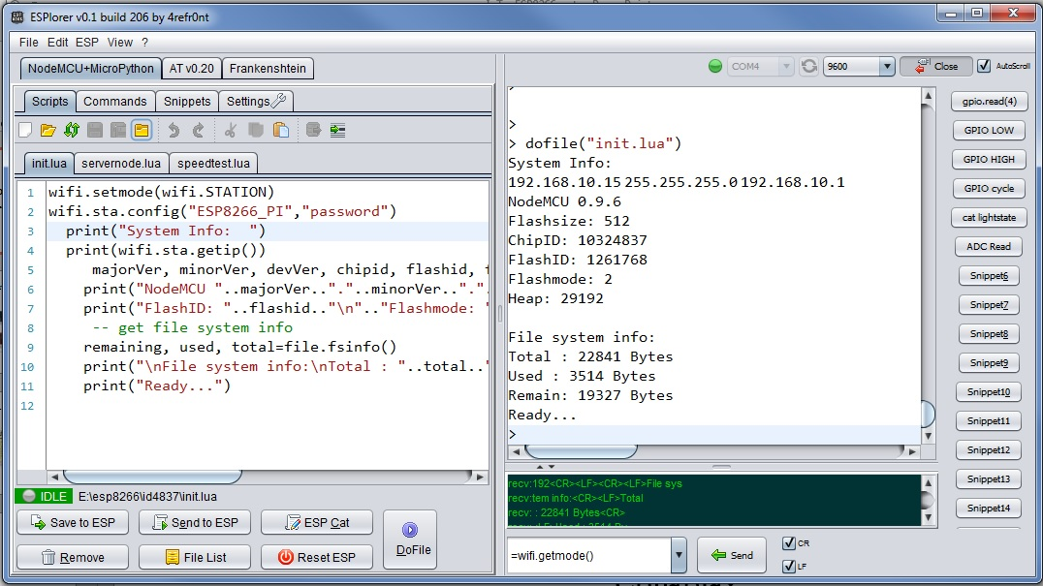
IDEs
ESPlorer
NodeMCU firmware

Slide 8
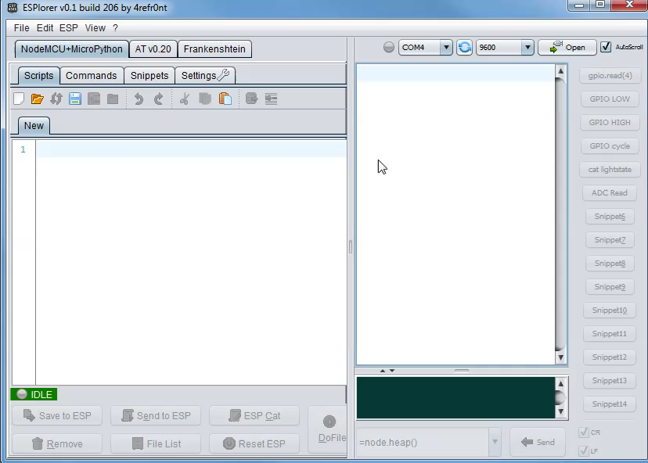

Slide 9
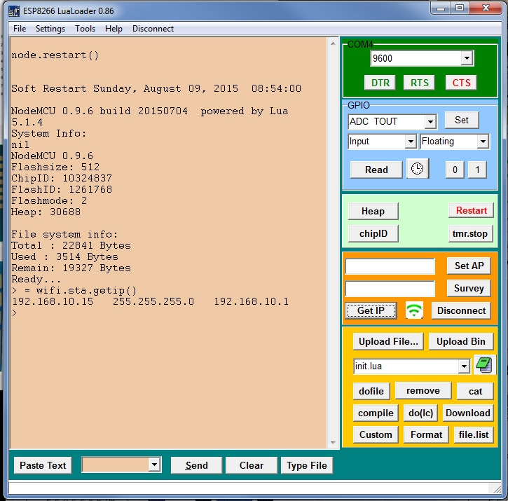
IDEs
LuaLoader

Slide 10
ESP8266 GPIO Mapping
IO index | ESP8266 pin | IO index | ESP8266 pin
0 [*] | GPIO16 | 7 | GPIO13
1 | GPIO5 | 8 | GPIO15
2 | GPIO4 | 9 | GPIO3
3 | GPIO0 | 10 | GPIO1
4 | GPIO2 | 11 | GPIO9
5 | GPIO14 | 12 | GPIO10
6 | GPIO12 | - | -

Slide 11
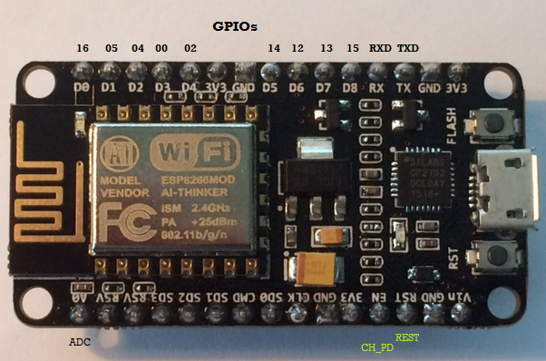
NodeMCU Breakout Board

Slide 12
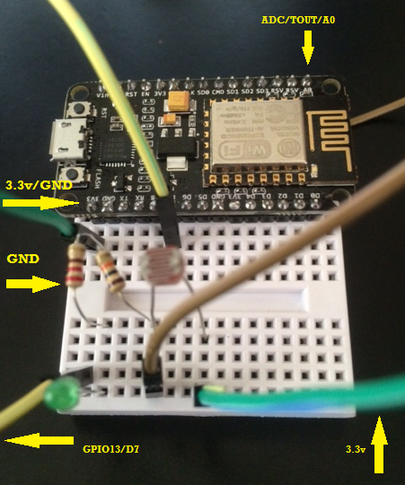
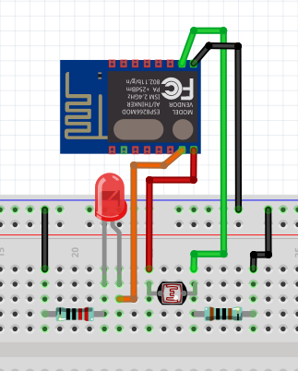
Nightlight/Server Circuit
GPIO13 – Orange TOUT – Green Vcc – Red GND - Black
220 Ohm 10K Ohm

Slide 13
Programming the ESP8266
LUA files can be found on WiFi server:
SSID: ESP8266_PI Pass: password
Home page: http://192.168.10.1
http://192.168.10.1/workshop01/LUA_files/

Slide 14
Init (startup) LUA script
init.lua
wifi.setmode(wifi.STATION)
wifi.sta.config("ESP8266_PI","password")
print("System Info: ")
print(wifi.sta.getip())
majorVer, minorVer, devVer, chipid, flashid, flashsize, flashmode, flashspeed = node.info();
print("NodeMCU "..majorVer.."."..minorVer.."."..devVer.."\nFlashsize: "..flashsize.."\nChipID: "..chipid)
print("FlashID: "..flashid.."\n".."Flashmode: "..flashmode.."\nHeap: "..node.heap())
-- get file system info
remaining, used, total=file.fsinfo()
print("\nFile system info:\nTotal : "..total.." Bytes\nUsed : "..used.." Bytes\nRemain: "..remaining.." Bytes")
print("\n")
--dofile("servernode.lua")
--dofile("nightlight.lua")
--dofile("mqtt2.lua")

Slide 15
Night Light LUA script
nightlight.lua
-- Nightlight script
pin= 7 -- GPIO13
gpio.mode(pin, gpio.OUTPUT) -- sets GPIO13
triggerlevel = 800 -- sets the level that turns LED on 0-1024
print("Nightlight running...") -- debug
tmr.alarm(1, 500, 1, function() -- script loops every half second 500ms
local ADClevel = adc.read(0) -- Reads ADC PIN
print("ADC: "..ADClevel) -- debug
if ADClevel < triggerlevel then -- if,then turn GPIO on/off based on
gpio.write(pin, gpio.HIGH) -- ADC reading 0-1024
-- print("led on") -- debug
else -- turns GPIO off if condition not true
gpio.write(pin, gpio.LOW)
-- print("led off")
end
collectgarbage()
end )

Slide 16
Basic Server LUA script
servernode.lua
-- create a server
sv=net.createServer(net.TCP, 10)
-- server listen on 80, if data received, print data to console,
--and send "hello world" to remote.
sv:listen(80,function(conn)
conn:on("receive", function(conn, pl)
payload = pl;
conn:send("<html />")
conn:send("<B/>ESP8266 chipID: "..node.chipid())
conn:send("<br/>Hello world!")
conn:send("<br />ADC: "..adc.read(0))
print(pl)
collectgarbage()
conn:close()
end)
end)
print("Server running...")

Slide 17
Basic Server LUA script #2
servernode2.lua
pin= 7 -- GPIO13
gpio.mode(pin, gpio.OUTPUT)
-- create a server
sv=net.createServer(net.TCP, 10)
sv:listen(80,function(conn)
conn:on("receive", function(conn, pl)
if string.find(pl,"led=on") then
gpio.write(pin, gpio.HIGH)
print("led set to HIGH")
end
if string.find(pl, "led=off") then
gpio.write(pin, gpio.LOW)
print("led set to LOW")
end
conn:send("<html />")
conn:send("<B/>ESP8266 chipID: "..node.chipid())
conn:send("<br/>Hello world!")
conn:send("<br />GPIO13: "..gpio.read(pin))
print(pl)
collectgarbage()
conn:close()
end)
end)
print("Server running...")

Slide 18
Server LUA script #2
Turn Led ON - http://192.168.10.xx/led=on
Turn Led OFF - http://192.168.10.xx/led=off
led set to LOW
GET /led=off HTTP/1.1
Host: 192.168.10.18
Connection: keep-alive
Cache-Control: max-age=0
Accept: text/html,application/xhtml+xml,application/xml;q=0.9,*/*;q=0.8,image/webp
User-Agent: Mozilla/5.0 (iPhone; CPU iPhone OS 8_4 like Mac OS X) AppleWebKit/600.1.4 (KHTML, like Gecko) CriOS/44.0.2403.67 Mobile/12H143 Safari/600.1.4
Accept-Encoding: gzip, deflate, sdch
Accept-Language: en-US,en;q=0.8
GET /favicon.ico HTTP/1.1
Host: 192.168.10.18
Connection: keep-alive
User-Agent: Mozilla/5.0 (iPhone; CPU iPhone OS 8_4 like Mac OS X) AppleWebKit/600.1.4 (KHTML, like Gecko) CriOS/44.0.2403.67 Mobile/12H143 Safari/600.1.4
Accept-Encoding: gzip, deflate, sdch
Accept-Language: en-US,en;q=0.8

Slide 19
Basic Server LUA MQTT
MQTT2.lua
pin= 7 -- GPIO13
gpio.mode(pin, gpio.OUTPUT)
m = mqtt.Client(wifi.sta.getmac(), 120, "", "")
-- on publish message receive event
m:on("message", function(conn, topic, data)
print(topic .. ":" )
if data ~= nil then
print(data)
if topic == "LED_Status" and data == "ON" then
gpio.write(pin, gpio.HIGH)
else
gpio.write(pin, gpio.LOW)
end
end
end)
tmr.alarm(0, 1000, 1, function()
if wifi.sta.status() == 5 then
tmr.stop(0)
m:connect("192.168.10.1", 1883, 0, function(conn)
print("connected")
m:subscribe("LED_Status",0, function(conn)
m:publish("ADC","ChipID: "..node.chipid().." ONLINE !!",0,0, function(conn)
print("sent") end)
end)
tmr.alarm(2, 5000, 1, function()
adcval = adc.read(0)
m:publish("ADC","ChipID: "..node.chipid().." ADC: "..adcval,0,0, function(conn)
print("sent "..adcval) end)
end)
end)
end
end)

Slide 20
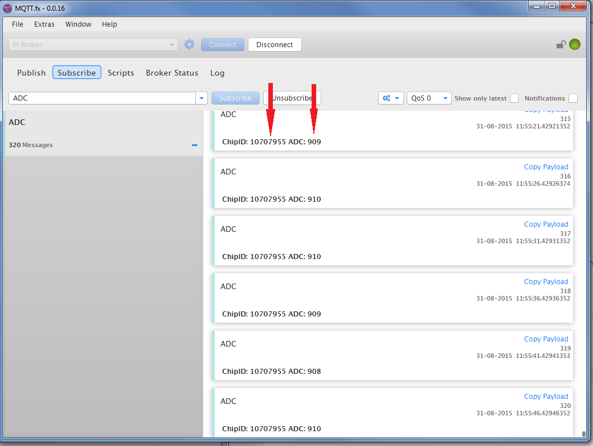
MQTT Lens

Slide 21
ESP8266 Resources:
During this workshop the files and resources can be found on WiFi server:
SSID: ESP8266_PI Pass: password
Home page: http://192.168.10.1
NodeMCU – API: https://github.com/nodemcu/nodemcu-firmware/wiki/nodemcu_api_en
Files used in this workshop: https://github.com/breagan/ESP8266_Workshop_01
Bruce Reagan
esp8266@airetraffic.com

